Slide 1
Color Engine SOP
skyforce / RSEE4
2010/08/05

Slide 2
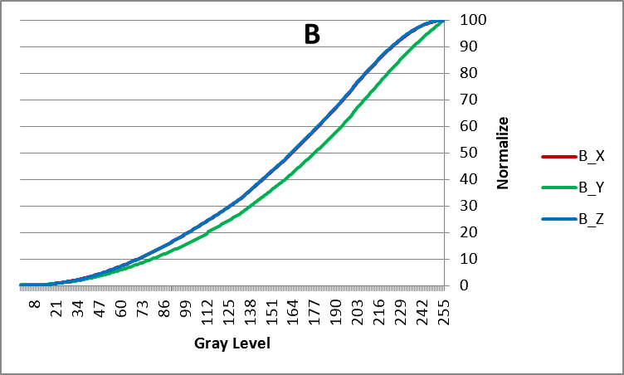
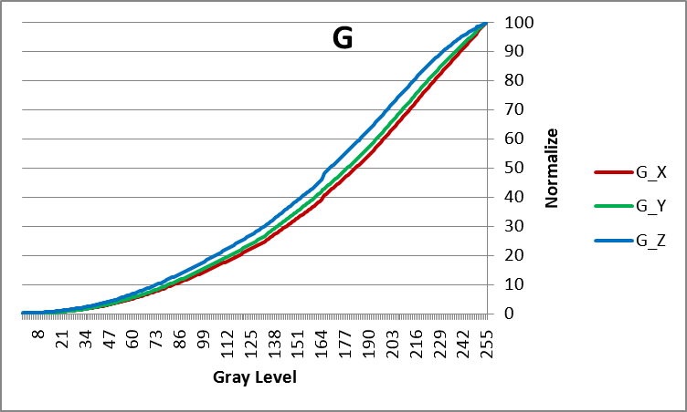
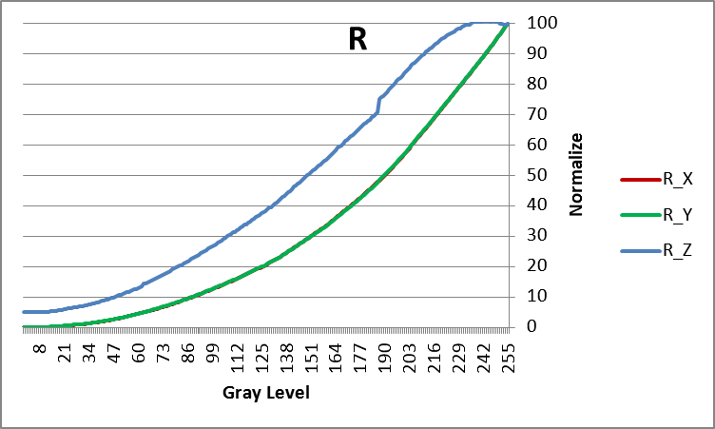
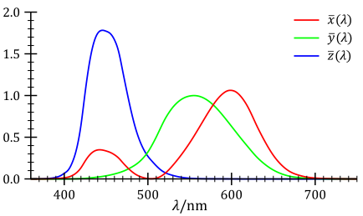
Why CCT?
為何要做CCT?
面板原始色溫即非穩定不變
色溫變化的原因
R、G、 B不同灰階下光譜穿透率不一致
Transmission Characteristic
穿透率與波長具相關性，同樣電壓下不同波長穿透率皆不同
LC Transmission formula
u: 相位差
Δn: 光程差, 隨液晶旋轉角度而改變
d: cell gap (distance of ITO)
λ: wavelength
T: 穿透率
短波長區域
中波長區域
長波長區域
若波長與電壓無關， Nomalized的X、Y、Z應會重疊
CIE Z
CIE X₂
CIE X₁

Slide 3
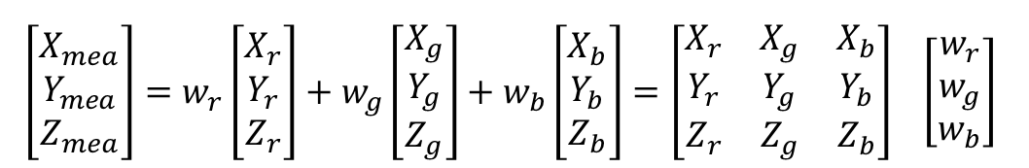
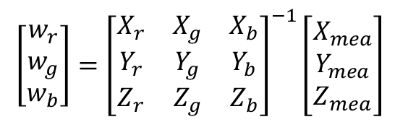
CCTv3 Improvement
Analyzer Mode Technique
計算primary color weight w_{r} w_{g} w_{b}
X_{r}Y_{r}Z_{r}、X_{g}Y_{g}Z_{g}、X_{b}Y_{b}Z_{b}
the outputs when measuring target primary R will be Xr, Yr, Zr
the outputs when measuring target primary G will be Xg, Yg, Zg
the outputs when measuring target primary B will be Xb, Yb, Zb
XYZ_{mea}
respective x, y, z sensor outputs of measure color
w_{r},w_{g},w_{b}
respective emission weighting for primary color R, G, B
Primary Color以w_{r},w_{g},w_{b} weighting組成XYZ _{mea}
由XYZ _{mea}推算w_{r},w_{g},w_{b} weighting值

Slide 4
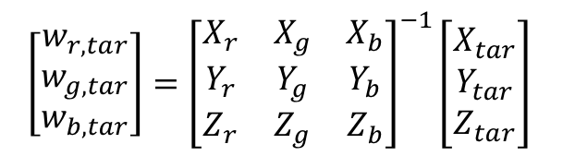
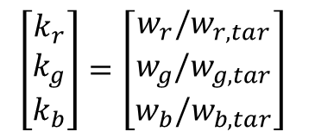
CCTv3 Improvement
Analyzer Mode Technique
計算target white intensity k_{r} k_{g} k_{b}
X_{r}Y_{r}Z_{r}、X_{g}Y_{g}Z_{g}、X_{b}Y_{b}Z_{b}
the outputs when measuring target primary R will be Xr, Yr, Zr
the outputs when measuring target primary G will be Xg, Yg, Zg
the outputs when measuring target primary B will be Xb, Yb, Zb
XYZ _{tar}
respective x, y, z sensor outputs of target white color
k_{r},k_{g},k_{b}
respective emission intensity for primary color R, G, B
which comprise the adjustment standard target white color W will all be equal to 1 (= 100%).
計算target white的w_{r},w_{g},w_{b} weighting值
Intensity k_{r},k_{g},k_{b}為相對於target white的weighting值

